Slide 1
BRITISH AIRWAYS
Predicting customer buying behaviour
DATE:09-03-2023

Slide 2
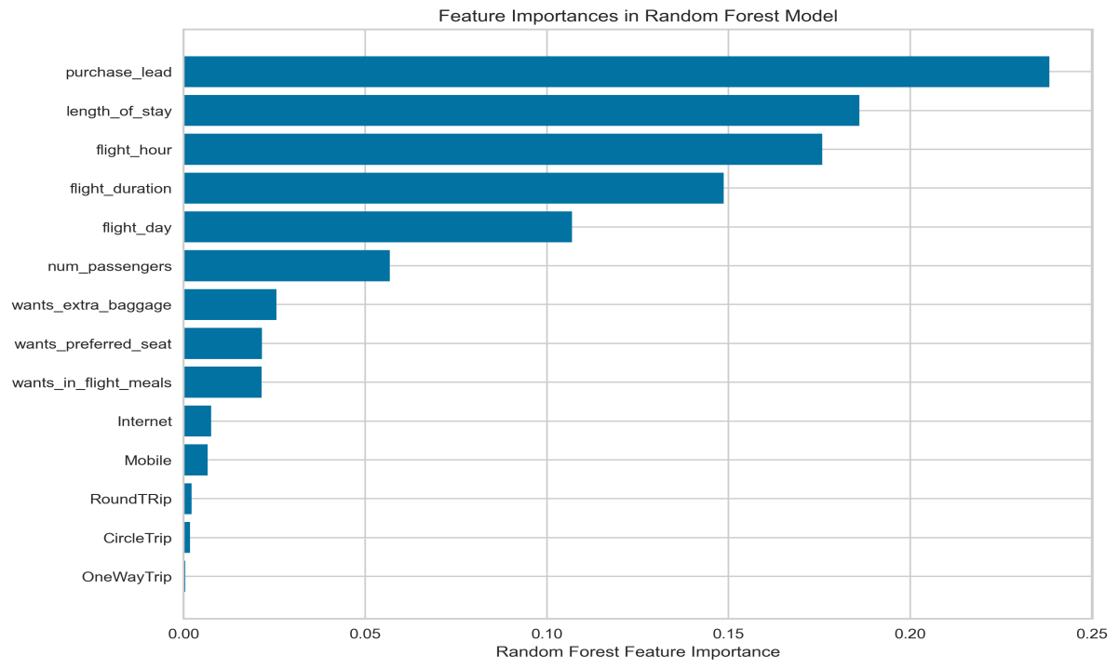
Prediction Results
Recall Rate: 62%
Our model has a recall rate of 62%, which indicates that 62% of genuine positive cases were accurately identified as such. This suggests that our model can detect a high proportion of positive cases.
Our precision is 65%, which indicates that 65% of correct positive predictions were made. This suggests that our model is producing a sufficient number of correct predictions.
Our prediction accuracy is 63%, which means that 63% of all predictions were right. This suggests that our model makes slightly better predictions than random chance, but there is still room for improvement.
Precision: 65%
Accuracy:
63%
Purchase lead time, length of stay, flight hours, and flight day are the most significant factors that influence a customer's likelihood to buy.
BA can use this information to target their marketing efforts towards these types of customers who book furthere in preparation, stay for longer benefit.
Dataset was balanced with 7k booking complete.

